Slide 1
UVA Community Health
Nursing Strategic Contributions
FY 2025

Slide 2
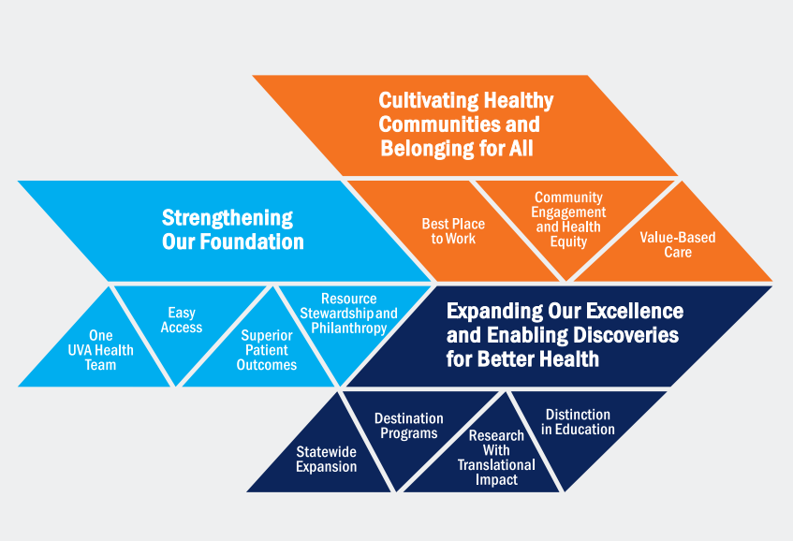
UVA Community Health FY2025 Nursing Strategic Contributions
The FY25 Nursing Strategic Plan is aligned with the 2022- 2032 UVA Health Strategic Plan: One Future Together: Health and Hope for all. Specific Nursing Key Activities reflect specific nursing related work to achieve these organizational goals

Slide 3
UVA Community Health FY2025 Nursing Strategic Contributions
UVA Health Strategic Goal
Cultivating Healthy Communities and Belonging for All
UVA Health Strategic Goal
Strengthening Our Foundation
UVA Health Strategic Goal
Expanding our Excellence and Enabling Discoveries for Better Health
Goal: Reinvigorate our workforce by cultivating their sense of purpose and belonging
Owner: NPGO Council
Review/Redefine NPGO Structure for UVA CH
Explore barriers to Council participation
Ensure integration of NPGO members into standing UVA CH committees
Strengthen NPGO chair/chair elect presence/input as part of Nursing Executive Council
Goal: Stabilize the nursing workforce with innovative flexible solutions
Owner: NPGO Council and Operational leaders
Develop and implement a Nurse Staffing Committee based on framework recommendations from VHHA and VNA.
Develop flexible staffing options:
Improve Workforce Analytics:
Optimize Kronos
Implement Values-based Hiring to reduce turnover and increase retention
Goal: Expand nursing research and Utilization of EBP to ensure optimal care delivery.
Owner: NPGO: Research Council
Support increased resources for EBP:
EBP boot camps
EBP Academy
Individual coaching
Goal: Exceed Magnet standards and achieve re-designation
Owner: Center of Nursing Excellence
Establish a writing team workflow
Mitigate gaps
Goal: Review and refine the Clinical Career Ladder
Owner: NPGO, CNO
Incentivize growth
Mitigate gaps in opportunity
Incorporate interviews to hardwire growth mapping
Goal: Achieve targets in nursing sensitive clinical outcomes using our NPGO structure
Owner: NPGO
Establish new or leverage existing forums to promote inter-professional and inter-departmental collaboration to promote excellence and address care delivery barriers
Goal: Implement Revised Professional Certification Program
Owner: NPGO, CNO
Provide access to all nurses by reducing out-of-pocket costs

Slide 4
UVA Health Medical Center FY25 Nursing Strategic Contributions
Best Place to Work: We care deeply about our people and building a great culture. In the face of national workforce shortages, UVA Health must be a destination for talent at every level by becoming the best place to work, learn, and grow. Illustrative key activities include:
• UVA Health Leadership Academy/ LEAP Program
• Foster a culture of “yes” and innovation
• Enhancing and expanding HR services aimed at optimizing recruitment and retention, and cultivating a workplace of choice
• Reinvigoration of the Clinical Career Ladder
• Magnet re-designation
• Reinvigorate our workforce by cultivating their sense of purpose and belonging.
Cultivating healthy communities and belonging for all
Nursing Key Activities | Owner/Leader
Analyze and present RN Engagement data to specific stakeholder groups and committees and support action plans and goal development. | Nursing Executive Council
Re-design Clinical Career Ladder advancement process based on clinician feedback to streamline application process and increase opportunities for advancement | NPGO Clinical Career Ladder Committee/ NEC
Host NPGO Strategic Planning workshop to provide tools and education for local NPG chairs and formal nurse leaders to establish or strengthen local NPG. | CNO/Center of Nursing Excellence
Conduct inventory of clinical nurse, APRN and nurse leader participation within all relevant organization inter-professional governance committees to ensure nursing input to organizational decision making | CNO/ NEC
Evaluate RN engagement survey scores for DEI and implement action plans and goal development. | NEC
Increase nursing professional certification to 2% by the end of FY25 | Center of Nursing Excellence
Implement nursing professional certification program | Center of Nursing Excellence
Increase awareness of access to RN to BSN programs | CNO/Center of Nursing Excellence
Community Engagement and Health Equity- We have a long-standing relationship with the communities we serve and seek to deepen our engagement and dialogue to collaboratively address their most pressing health needs. Illustrative key activities include:
  • Creating a workforce that resembles the communities we serve.
  • Opening new community based neighborhood clinics and outreach sites that address our community’s needs.
  • Expanding workforce programs to increase UVA Health recruitment from our communities, and foster equity and upward mobility; e.g., “Earn While You Learn.”
Nursing Key Activities | Owner/Leader
Launch integrated ‘Earn While you Learn’ and other investment-based programs | Center of Nursing Excellence

Slide 5
UVA Health Medical Center FY25 Nursing Strategic Contributions
One UVA Health : We will work as one UVA Health team by becoming a more integrated and aligned health system; (i.e., breaking down silos) in order to optimize our efficiency across all entities, and, thus, more fully achieve our missions to heal, to teach, and to discover. Illustrative key activities include:
• Aligning our clinical and research missions across UVA Health
• Achieving economies of scale and ensuring consistent patient experience
• Successfully integrating UVA Culpeper Medical Center, UVA Haymarket Medical Center, UVA Prince William Medical Center, and associated ambulatory operations onto UVA Health’s enterprise infrastructure to ensure a seamless care experience for patients and providers across all locations
Strengthening Our Foundation
Nursing Key Activities | Owner/Leader
Expand workforce analytics to support growth and automation of program throughout inpatient nursing and create consistency for budgeting and staffing analytics | Office of the CNO
Implement weekend program | Office of the CNO
Implement Nursing Staffing Committee based on guidelines provided by VHHA, in alignment with VNA to monitor metrics related to the impact of nurse staffing ratios and care outcomes. | CNO/Center of Nursing Excellence
Expand our workforce programs to support traveler reduction and staffing demands. Staff extenders Expanded float pool International nursing programs | Office of the CNO
Evaluate/revise recruitment process to incorporate values-based-hiring initiatives | NEC
Institute Value Analysis Committee (VAC) to support achieving economies of scale and alignment of nursing supplies/equipment across UVA Health | NPGO/Operational leaders
Superior Patient Outcomes: We will lead in the delivery of safe, high-quality, and patient-centered care. Illustrative key activities include:
• Fortifying a quality and safety infrastructure that enables consistent measurement and achievement of our quality scorecard targets.
• Enhancing coding efforts across UVA Health to assure that we understand the risk profile of each of our patients.
• Implementing additional clinical pathways to reduce unwarranted variation in care.
• Achieving top tier performance in nursing sensitive clinical outcomes using our Nursing Professional Governance Structure.
• Optimize clinical care delivery through enhancing operational relationships.
Nursing Key Activities | Owner/Leader
Establish new or leverage existing forums to promote inter-professional and inter-departmental collaboration to address care delivery barriers | Office of the CNO
Establish outcome- based champion structure including standardized role descriptions and communication mechanisms with outcomes resource groups (committees, coalitions, programs). | NEC

Slide 6
UVA Health Medical Center FY25 Nursing Strategic Contributions
Research with Translational Impact: We will strengthen UVA Health’s research enterprise as a hub for scientific discovery and its translation to clinical care. Illustrative key
activities include:
• Creating a new research facility and program focused on biotechnology and translational clinical care.
• Expanding our nationally distinctive research programs by recruiting over 100 net new physicians and scientists.
• Significantly expand access to clinical trials with the creation of a statewide clinical trials network.
• Expand Nursing Research, Evidence-based Practice and Performance Improvement at UVA and ensuring optimal care delivery at the point of care.
Expanding Our Excellence and Enabling Discoveries for Better Health
Nursing Key Activities | Owner/Leader
Assess leader understanding of EBP to obtain a baseline | Center of Nursing Excellence
Implement EBP scheduled offerings and “boot camp” training sessions to increase individual skill | Center of Nursing Excellence
Provide education aimed at increasing awareness and understanding of EBP | NPGO
Destination Programs: We will invest in our distinctive areas of expertise and expand UVA Health’s preeminence statewide, nationally, and around the world. Illustrative key activities include:
  • Recruiting, retaining, and nurturing world-class faculty members to lead and build nationally ranked destination clinical and research programs.
  Developing ambitious strategies to grow our service lines and major clinical programs.
  Raising UVA Health’s reputation and brand awareness statewide and elevating our national and international profile.
Nursing Key Activities | Owner/Leader
Complete Magnet gap analysis and develop action plans as needed. | Center of Nursing Excellence
Complete initial gap analysis for Magnet Pathways for HAMC and CPMC | Center of Nursing Excellence
Complete Magnet document production timeline and project plan | Center of Nursing Excellence
Convene Magnet Steering Team to provide oversight of document development, gap mitigation and site visit planning. | Center of Nursing Excellence

Slide 7
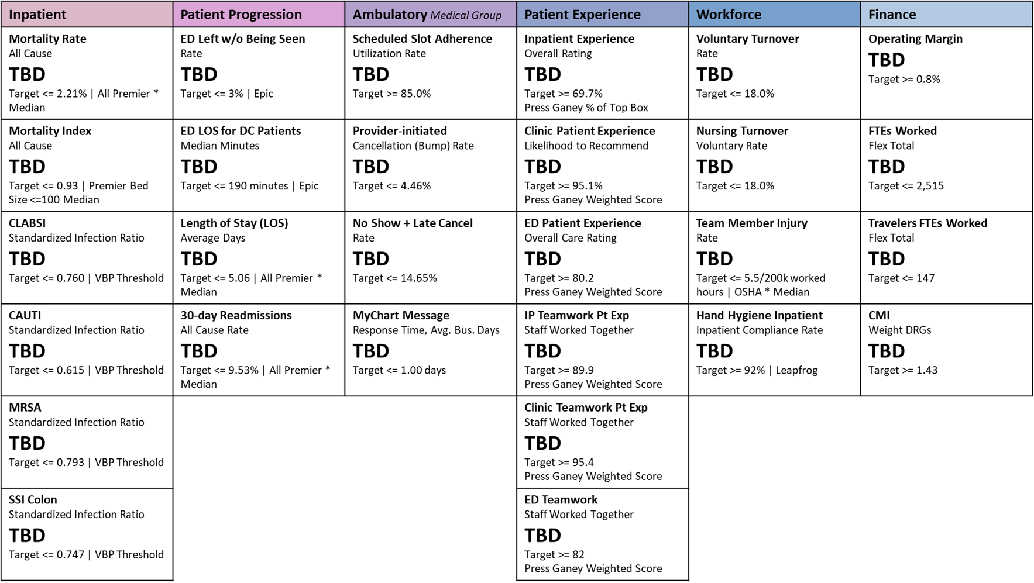
Clinical Operations Scorecard FY25

Slide 8
FY 2025 Nursing Dept Shared Goals
Goal 1: Quality Performance
Breakdown for Quality Goal Compliance %s
FY ‘25 Clinical Operations Scorecard
Mortality Index | ED Patient Experience
CLABSI | IP Teamwork Pt. Exp
CAUTI | ED Teamwork
MRSA | Voluntary Turnover
SSI Colon | Nursing Turnover
ED LWOBS | Team Member Injury
ED LOS for DC Pt | Hand Hygiene
LOS (Avg Days) | FTEs Worked
30-Day Readmissions | Travelers FTEs Worked
Inpatient Experience
Threshold | Target | Max
73% (14/19) | 84%(16/19) | > 88% (17/19)
*%’s for two facilities
(28/38; 32/38, 34/38)

